Slide 1
Planning and operating for Resiliency in Water and sewer services
Bryan R. Tillery, Manager of water quality/operations
Warren county water district

Slide 2
Warren County Water District
Joint Operations agreement with Simpson County Water District and Butler County Water System
47,000 accounts
1,200 mi² Service area
Population served: 88,000 people

Slide 3
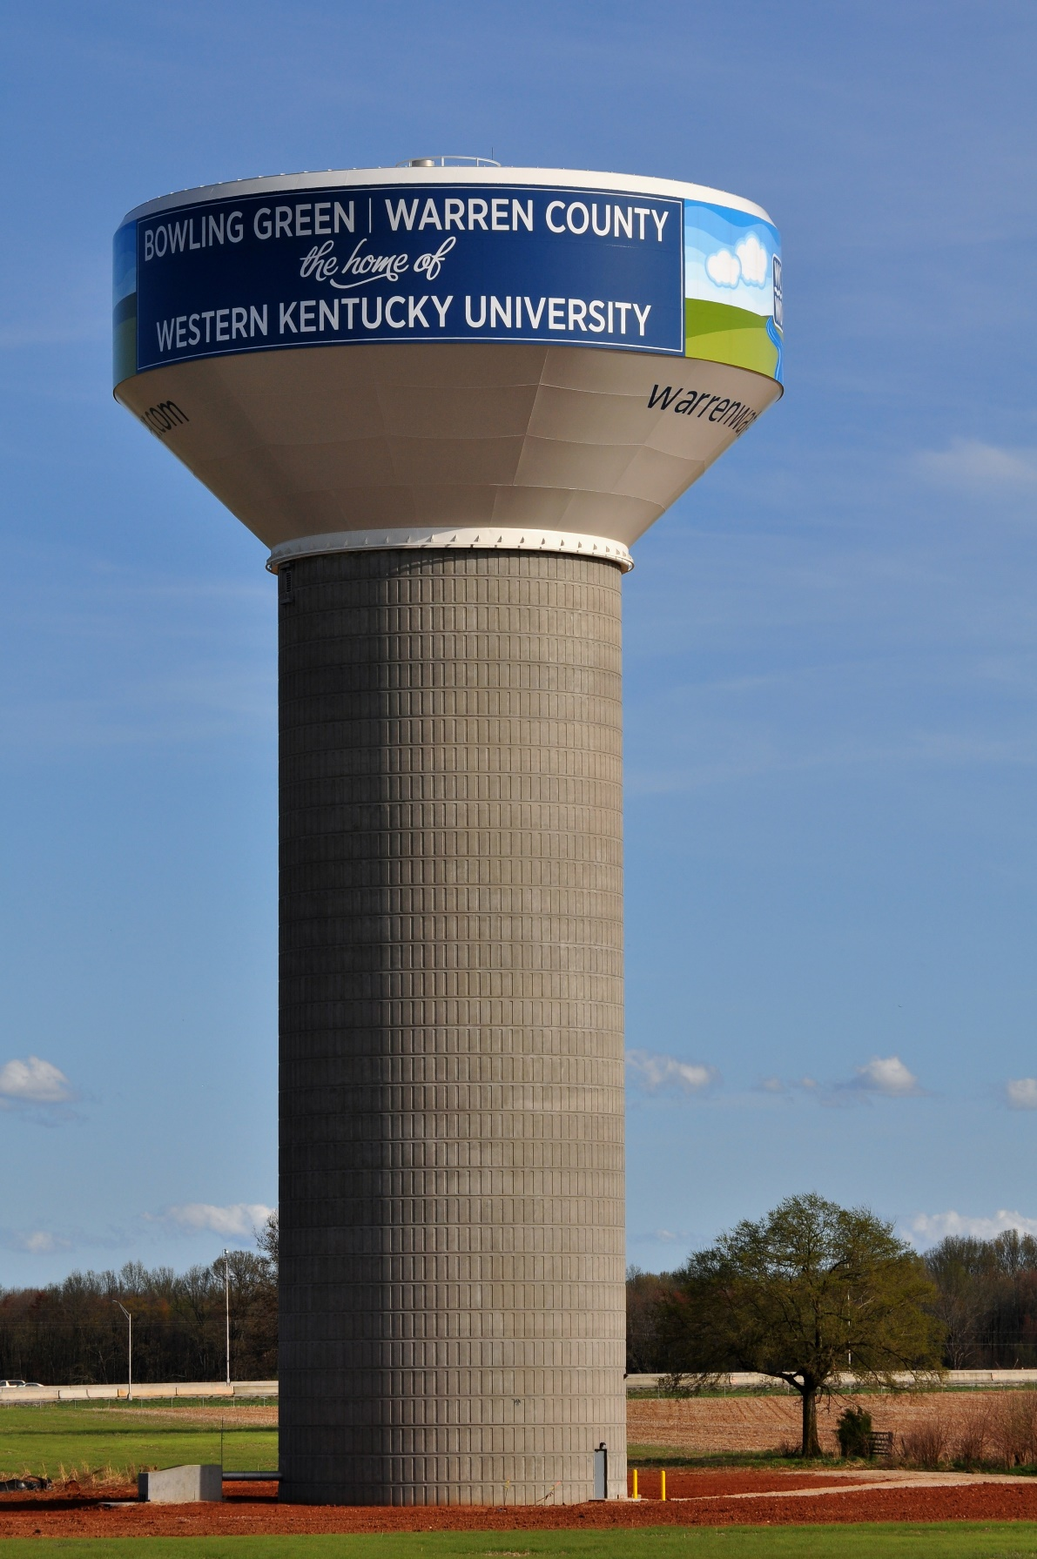
Resilient system design
Storage tanks
Distributed throughout system
24-hour+ Average day capacity
System pressurization via gravity

Slide 4
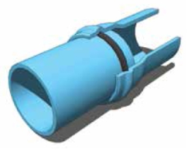
Resilient system design
Flexible Piping
Gasketed joints allow for angular deflection and axial deflection
Axial deflection allows for thermal expansion
Plastic material permits limited flexibility between pipe joints
Flexible piping better accommodates ground movement

Slide 5
Resilient system design
Redundant Facilities
Alternative transmission routes
Distributed transmission mains
Looped network of pipes
Redundant components at facilities

Slide 9
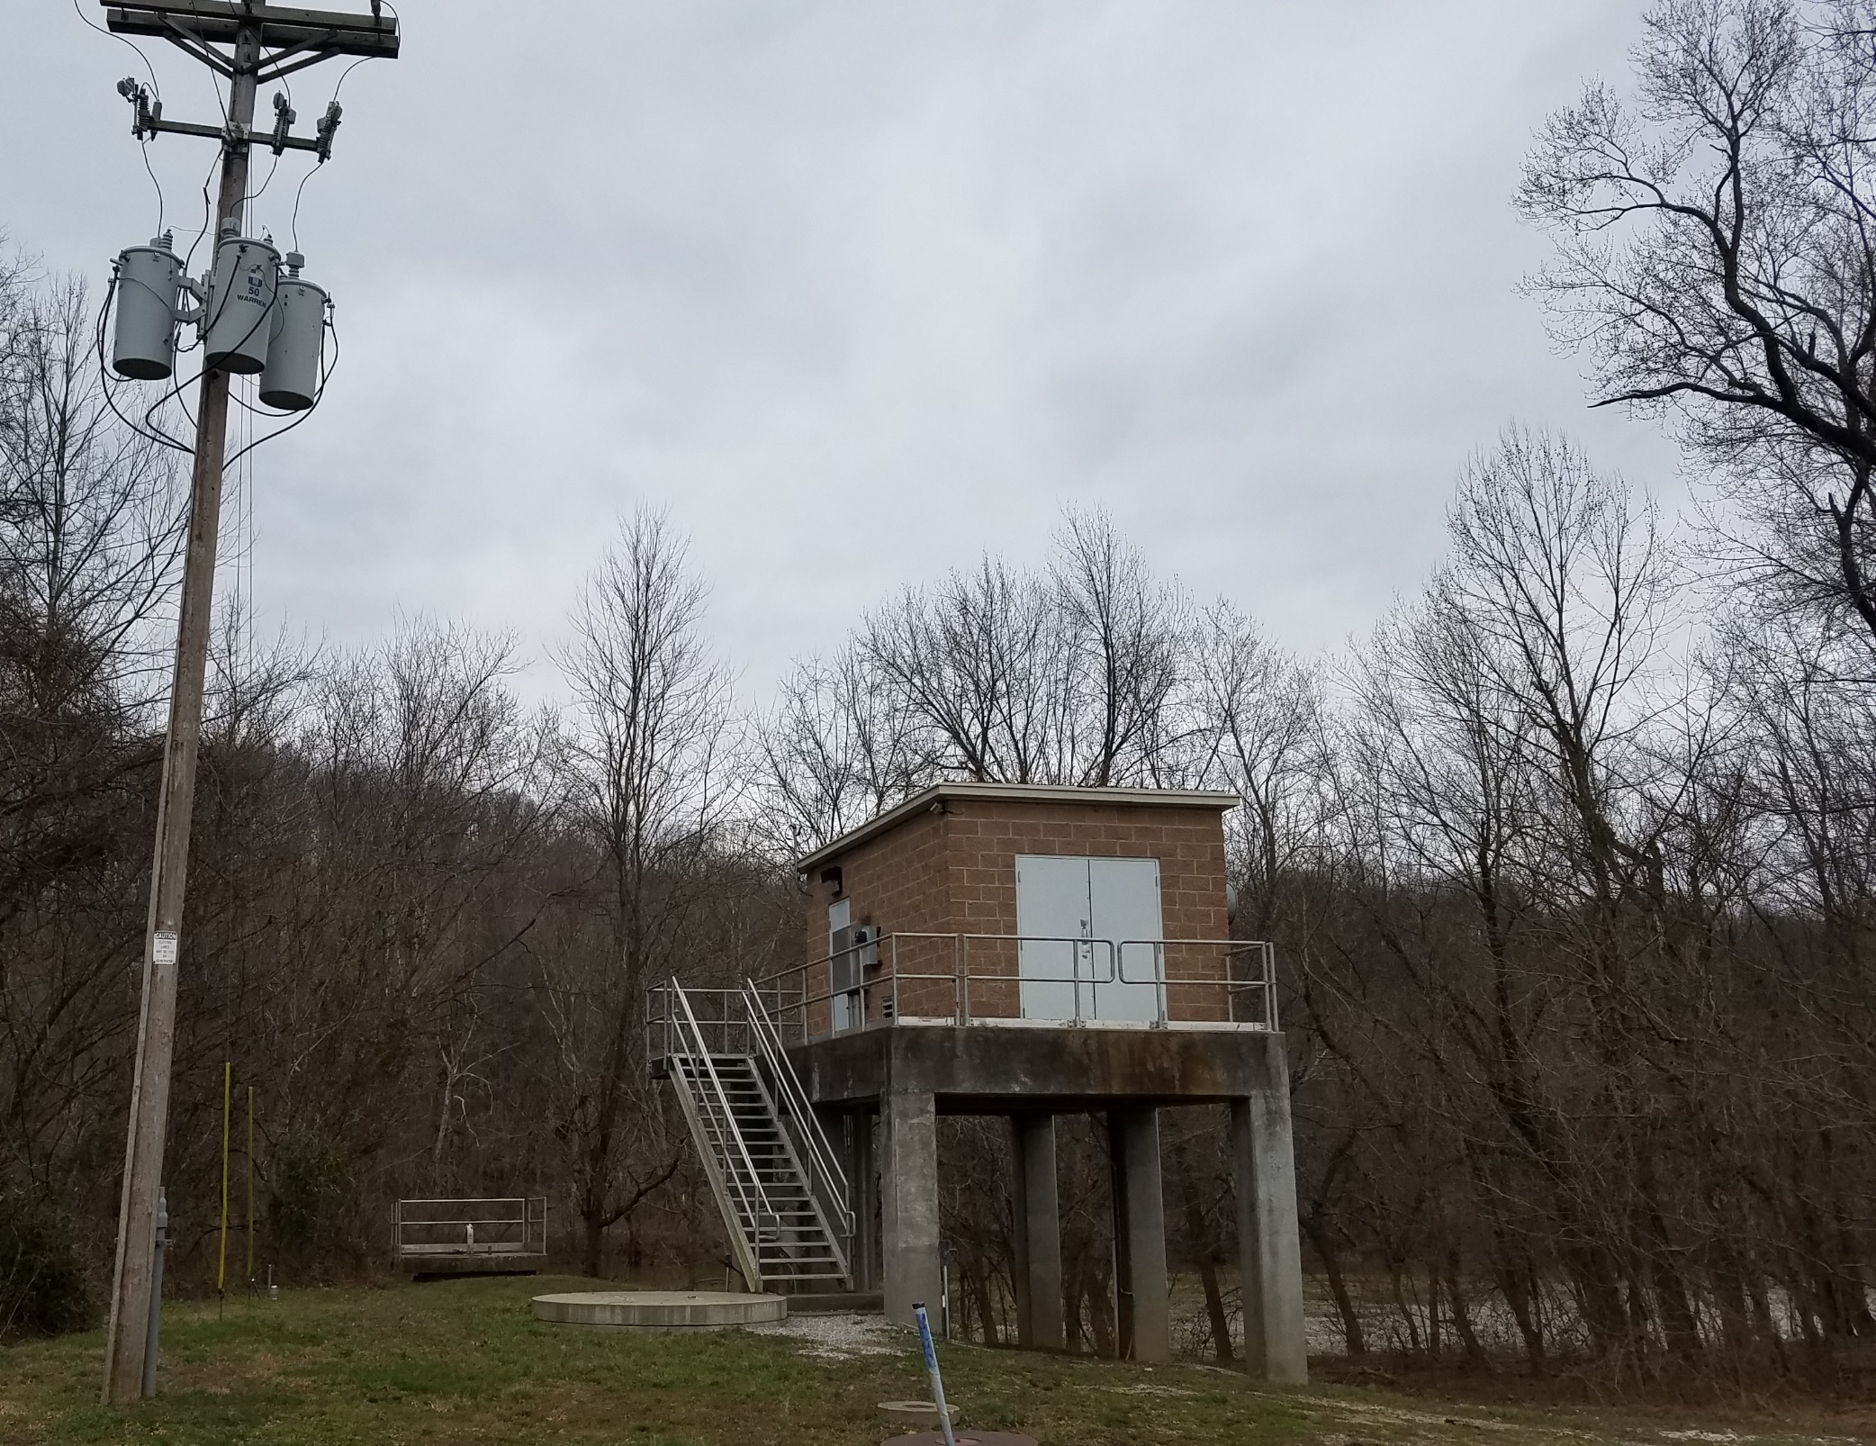
Butler County WTP Standby Power System
Challenge…
100 year flood level at Plant’s Raw water intake is 10 feet above grade
Plant’s raw water intake is 2,000 feet from water plant

Slide 10
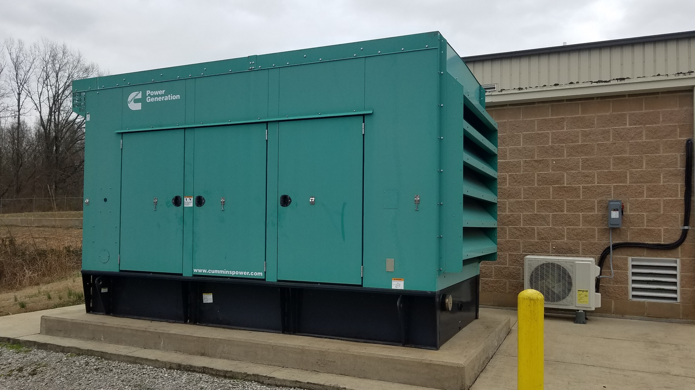
Butler County WTP Standby Power System
Solution…
Single generator for main plant and raw water intake
Isolate power distributor’s primary at plant
Energize power lines to raw intake with generator
Automatic transfer switch for plant
Manual transfer switch for raw water intake

Slide 11
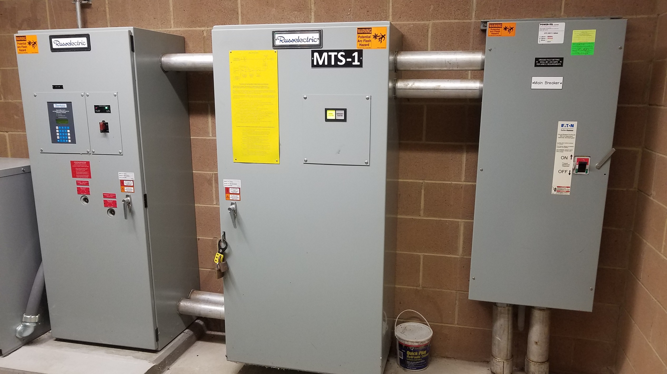
Butler County WTP Standby Power System
Safety
Numerous safety procedures in place
Safety interlock disables manual switch if power line is not isolated
manual switch door is double locked by both water district and power distributer
Switching procedures clearly and permanently posted

Slide 12
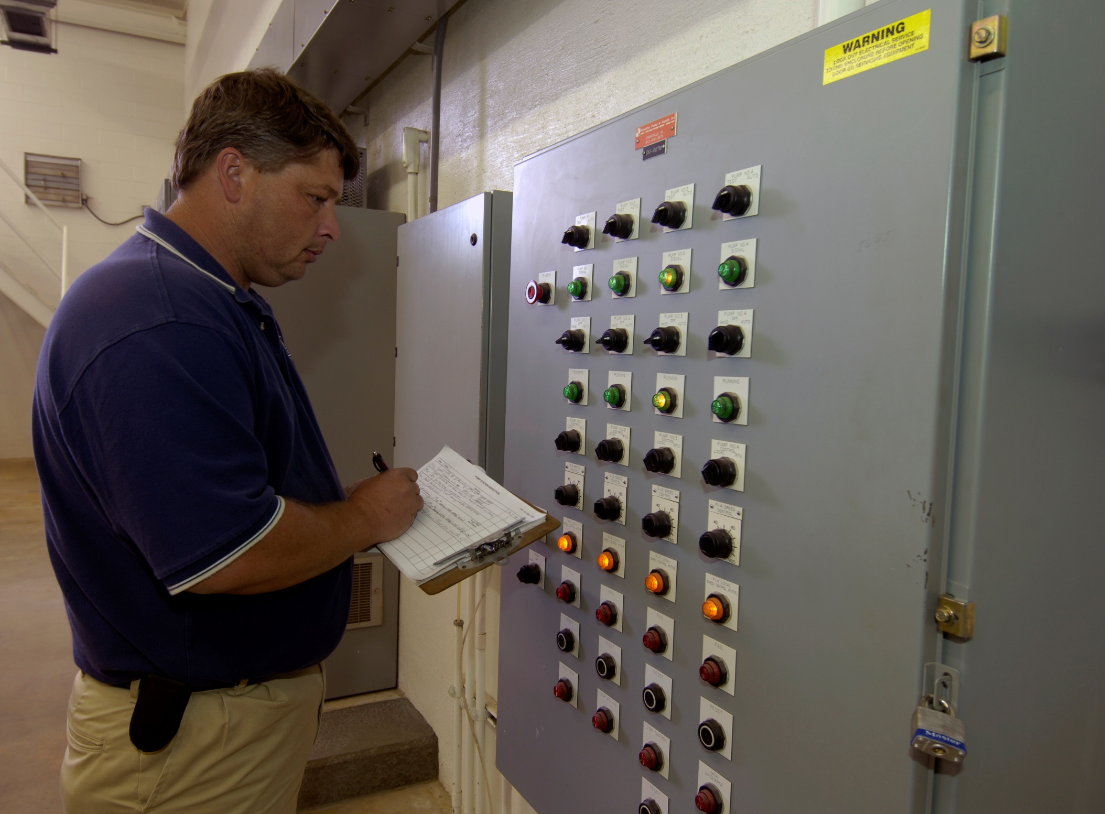
Resilient system Operation
Demand Response
TVA 30 minute program
Power Outage Exercise
“Event” Preparation
Spare & Repair components
Manual, non-automated Operability

Slide 13
Questions…
Contact:
Bryan R. Tillery
Warren county water district
bryant@warrenwater.com
www.warrenwater.com

